Slide 1


Vishwakarma Institute of Information Technology
Department of Information Technology
Subject: Artificial Intelligence
AI-Based Loan Approval Mechanism for Farmers: Enhancing Credit Accessibility through Weather and Crop Predictions
Presented by
SR. NO. | Roll Number | Name | PRN | Email ID
1 | 332004 | Sankalp Chakre | 22210615 | sankalp.22210615@viit.ac.in
2 | 332005 | Sarvesh Chaudhari | 22210831 | sarvesh.22210831@viit.ac.in
3 | 332011 | Nirdosh Chavhan | 22210030 | nirdosh.22210030@viit.ac.in
4 | 332021 | Adwait Gondhalekar | 22211523 | adwait.22211523@viit.ac.in
Guided by: Prof. Riddhi Mirajkar

Slide 2


Content
Introduction Literature Survey
Gap Analysis & Objectives Proposed System Results and Discussion Advantages and Disadvantages
Applications
Future Scope Conclusion References

Slide 3


INTRODUCTION
Agriculture is crucial for India's economy (17-18% of GDP, 60% of employment). Maharashtra relies heavily on seasonal crops, but farmers face challenges securing timely loans. Traditional loan approval systems are outdated and biased, leading to incorrect risk assessments. Climate change impacts farming cycles, increasing uncertainty in crop yields. High interest rates from moneylenders create unsustainable debt burdens for farmers. Uncertainty in rainfall and climate shifts aggravate risks, leading to lower crop yields. Consequences include :
financial insecurity, growing debts
reduced agricultural productivity
environmental degradation.
A data-driven loan approval mechanism using ML and AI is essential to improve decision-making for banks and farmers. Considers land area, soil quality, credit scores, farmer experience, and weather forecasts. Enhances loan approval accuracy and crop suitability recommendations, reducing risks for both farmers and banks.

Slide 4
Literature Survey
Paper Title | Technique Used | Working Methodology | Advantages | Limitations
Prediction of Loan Approval in Banks using Machine Learning Approach | KNN, Logistic regression., GLM1, Fannie Mae Public dataset (LPPUB) | KNN classifies loans by borrower similarities, Logistic Regression predicts approval probability, and GLM1 analyzes approval relationships | Improves loan approval accuracy by leveraging multiple machine learning models. | Model Performance Variability - No single model consistently outperforms others in all scenarios
Forecasting future crop suitability with microclimate data | WOFOST model | WOFOST simulates crop growth using weather data, soil characteristics, and crop parameters to forecast yield potential. | Used microclimate modelling techniques to generate 100 m spatial resolution climate datasets | The model does not consider non-climatic factors that can affect crop suitability (like soil quality) Limited crop variety(56)
A Survey of Weather Forecasting based on Machine Learning and Deep Learning Techniques | KNN K- mean Decision Tree CRBM CN | K-means clusters patterns, Decision Tree makes sequential predictions, CRBM models temporal dependencies, and CNN captures spatial weather patterns. | Real-time Processing Adaptive Learning Cost-Effectiveness Improved Accuracy | Incomplete Data Ignoring Drastic Climate Changes Focused on Particular Region
Service 01

Slide 5

Literature Survey
Paper Title | Technique Used | Working Methodology | Advantages | Limitations
Impact of climate change on crop suitability in sub-Saharan Africa in parameterized and convection-permitting regional climate models | CMIP5 GCM simulations CORDEX Africa RCM simulations | CMIP5 GCM simulations and CORDEX Africa RCM simulations assess climate change impacts on crop suitability in sub-Saharan Africa. | Got the very accurate result for Soyabean and Cassava. | The study did not fully account for the impact of extreme temperatures on soybean and cassava, only maize.
Machine Learning (ML) Technologies for Digital Credit Scoring in Rural Finance: A Literature Review | ANN SVM Logistic Regression Random Forest | ANN identifies credit patterns, SVM classifies risk, Logistic Regression estimates probabilities, and Random Forest improves accuracy. | Appropriate ML algorithm that fits the credit assessment specifically for rural borrowers. | Integrating traditional and digital credit scoring methods without ethical challenges
Service 01

Slide 6
GAP ANALYSIS
Outdated or Limited Data
Lack of Comprehensive Variable Consideration
Model Performance Variability
Exclusion of Non-Climatic Factors in Crop Suitability
Limited Geographic Scope
OBJECTIVES
Improve Loan Accessibility
Reduce Financial Risk
Increase Decision-Making Accuracy
Improve productivity and sustainability
Incorporate climate factors

Slide 7

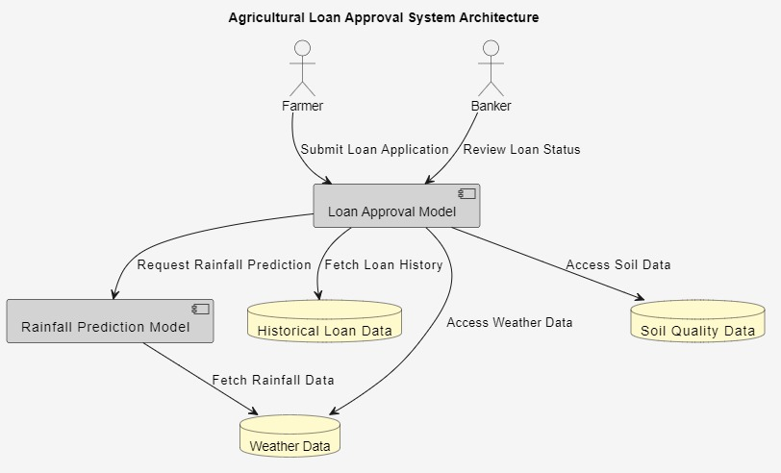
Proposed Methodology
Data Collection: The agricultural loan approval model used data collected from government databases and financial institutions.
Data Preprocessing: Handling of missing values, and improper values.
Feature Engineering: The agriculture loan approval model includes several salient features to increase accuracy. They include Land Area, Soil Quality Index, Date of Planting and Date of Harvesting, Proposed Crop, Credit Score, and Location and present insights on suitability as well as risk.
Fig. 1 Architecture of System

Slide 8
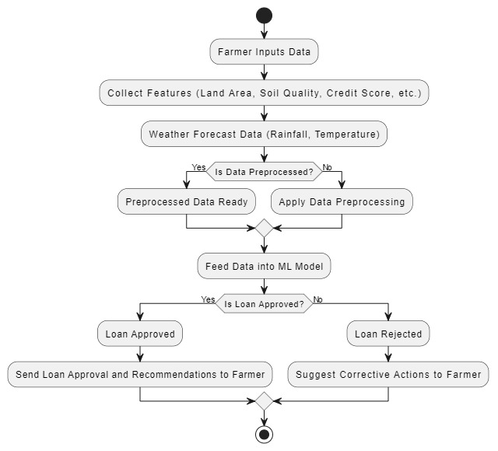
Proposed Methodology
Rainfall Prediction: Use an LSTM model to forecast rainfall based on historical weather data.
Model Selection: Implemented XGBoost for loan approval predictions.
Model Training: Split data into 80% training and 20% testing subsets.
Model Evaluation: Assessing performance with accuracy, confusion matrix, execution speed
Continues Learning: Implement adaptive learning to update models with new data, ensuring accuracy.
Fig.2 Flow of System

Slide 9
RESULTS and DISCUSSION
Model Performance:
Random Forest showed the highest accuracy at 99.82%, making it the best model for correctly classifying loan applications.
XGBoost closely followed with an accuracy of 99.71%, achieving a balance between accuracy and execution time, making it a highly efficient option.
Support Vector Machine (SVM), though having the shortest execution time of 0.8018 seconds, lagged behind in terms of accuracy at 95.08%, indicating limitations for this application.
Execution Time:
Random Forest took the longest execution time at 3.2406 seconds, which is offset by its high accuracy.
XGBoost offered a more optimal balance, with a faster execution time of 1.5893 seconds while maintaining high accuracy.
SVM was the fastest but at the cost of lower accuracy, making it less favorable for applications that prioritize precision.
Model | Accuracy | Execution Time(sec)
Random Forest | 99.82% | 3.2406
XGBoost | 99.71% | 1.5893
SVM | 95.08% | 0.8018
Table 1. Comparison of Models

Slide 10
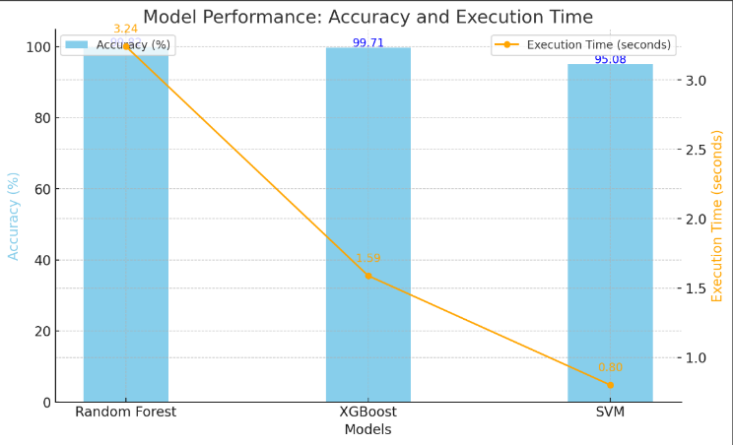
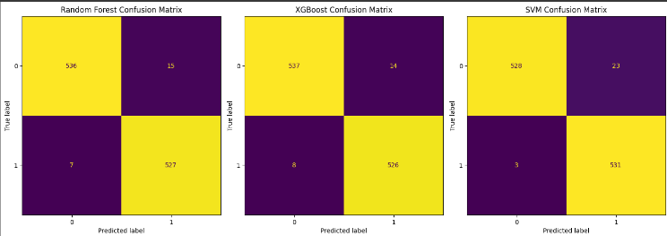
RESULTS and DISCUSSION
Fig. 4 Confusion matrix
Confusion Matrix Analysis (Fig. 4) further supports these findings, showing the correct and incorrect classifications of the loan applications, highlighting Random Forest's superior performance in minimizing misclassifications.
Fig. 3 Comparisons of Models
Overall, the results demonstrate that advanced machine learning algorithms like Random Forest and XGBoost can significantly improve the efficiency and reliability of agricultural loan approval systems, benefiting both farmers and financial institutions

Slide 11

ADVANTAGES AND DISADVANTAGES
ASPECTS | ADVANTAGES | DISADVANTAGES
Data-Driven Approach | Efficient, transparent, and unbiased decision-making for loan approval | Limited by the quality and completeness of input data.
Machine Learning Models | XGBoost, Random Forest, SVM offer high accuracy and faster decision-making. | SVM slower than other models, trade-off between speed and accuracy in XGBoost.
Rainfall Prediction | LSTM model reduces financial risks by improving crop prediction. | Requires precise historical and real-time weather data, which may be lacking.
Feature Engineering | Considers multiple relevant features (land area, soil quality, rainfall). | Complex features may overfit or introduce noise if not properly tuned.

Slide 12

APPLICATIONS
Banks and Financial Institutions: Use AI/ML models to assess loan applications based on crop and climate data
Agricultural Planning: Provide personalized crop recommendations to farmers based on land, soil, and weather forecasts.
Government Schemes: Integrate the model into government-led initiatives to ensure more equitable loan distribution.
Insurance Companies: Improve risk modeling for crop insurance using real-time data.
Sustainable Farming: Promote data-driven decision-making that encourages environmentally sustainable practices.

Slide 13
CONCLUSION
The AI-based agricultural loan approval model enhances loan accessibility by incorporating essential features like weather forecasts, soil quality, and farming experience.
XGBoost provides the best balance between accuracy and speed, while Random Forest delivers the highest accuracy.
By reducing financial risks for farmers and banks, this model contributes to agricultural sustainability and food security.

Slide 14
Future Scope
Real-time Weather Updates: Incorporate live weather data for more accurate predictions.
Integration of Satellite Data: Improve crop and soil assessments through remote sensing.
Alternative Credit Scoring: Use non-traditional data sources for more inclusive credit assessments.
Nationwide/Global Expansion: Apply the model to different climatic regions for wider agricultural financing.

Slide 15
References
Viswanatha, V., Ramachandra, A. C., Vishwas, K. N., & Adithya, G. (2023). Prediction of loan approval in banks using machine learning approach. International Journal of Engineering and Management Research, 13(4), 7-19. link
Gardner, A. S., Maclean, I. M. D., Gaston, K. J., & Bütikofer, L. (2021). Forecasting future crop suitability with microclimate data. Agricultural Systems, 190, 103084. link
Bhawsar, M., Tewari, V., & Khare, P. (2021). A survey of weather forecasting based on machine learning and deep learning techniques. International Journal of Emerging Trends in Engineering Research, 9(7). link
Chapman, S., E Birch, C., Pope, E., Sallu, S., Bradshaw, C., Davie, J., & H Marsham, J. (2020). Impact of climate change on crop suitability in sub-Saharan Africa in parameterized and convection-permitting regional climate models. Environmental Research Letters, 15(9), 094086. link
Kumar, A., Sharma, S., & Mahdavi, M. (2021). Machine learning (Ml) technologies for digital credit scoring in rural finance: a literature review. Risks, 9(11), 192. link

Slide 16
Thank You

